Slide 1
Workshop &
Learning Center
3rd Floor
Community Center

Slide 2
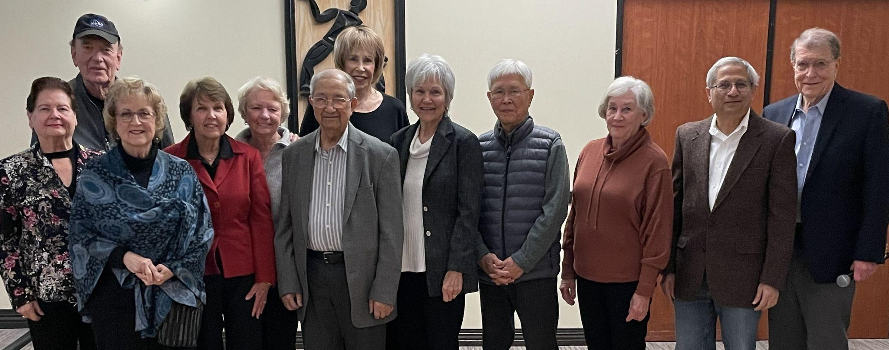
PC Club All Volunteer Operation
Established 1984
2002 moved to 3rd Floor, Village Community Center
Serves All Village Residents
68 Volunteers:
- 13 Greeters (welcome visitors, register students, make taxpayers’ appts.)
- 28 Supervisors (assist one-on-one hardware/software)
- 12 Class Instructors
- 15 Board Members →

Slide 3
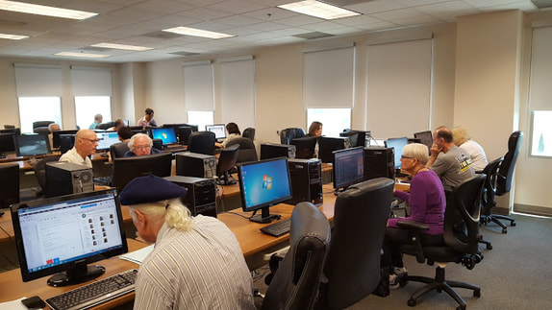
PC Club Workshop
Open Weekdays 10:00am-4:00pm
24 Computers/2 Chromebooks for residents’ use
3 Scanners (document & photo)
3 Printers (b&w and color)
Photo-Editing software

Slide 4
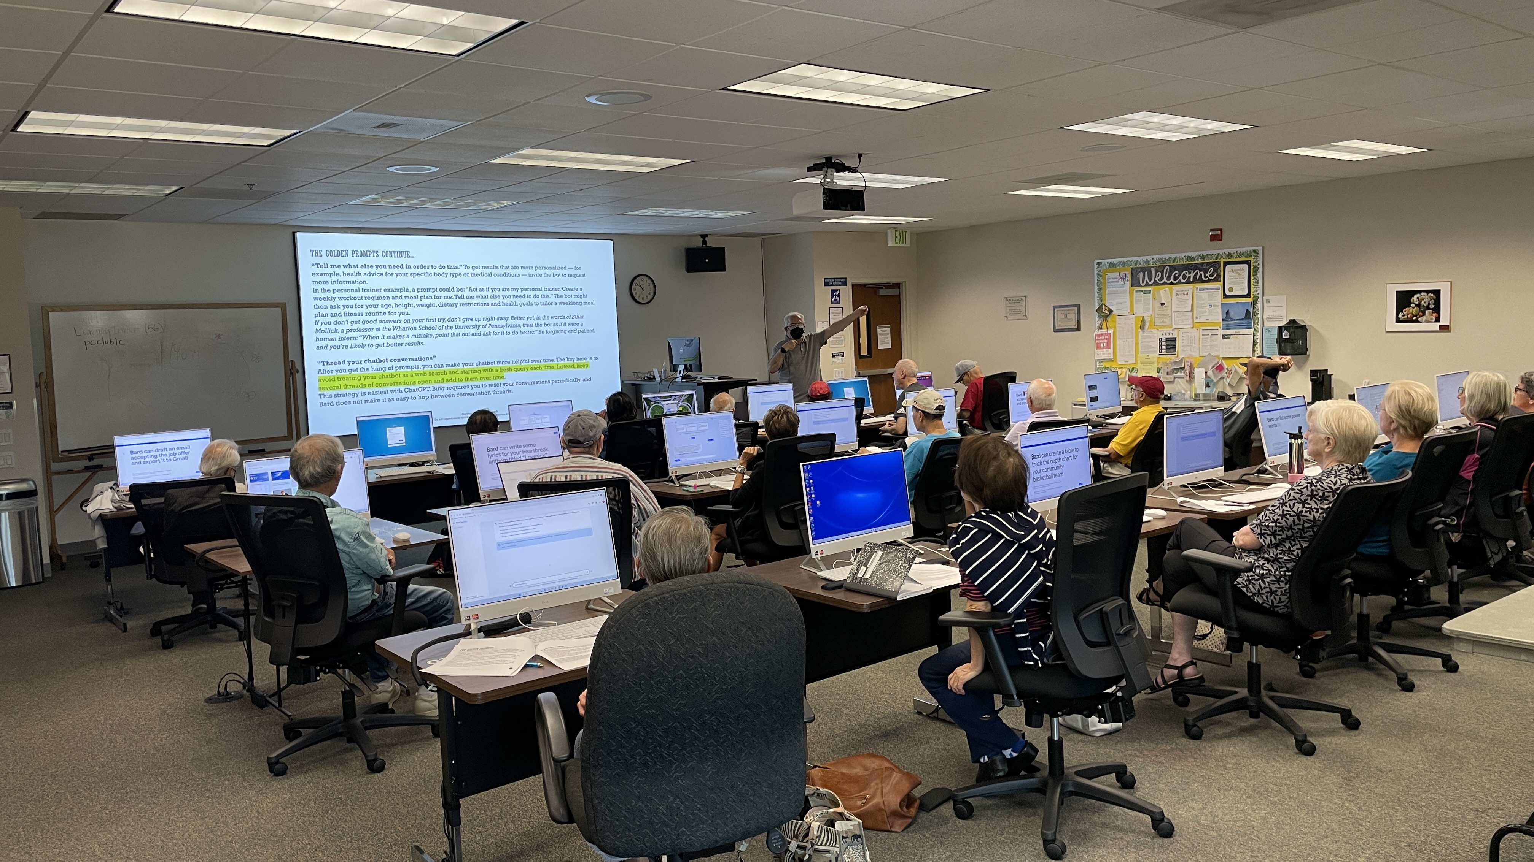
PC Club Learning Center
Classroom with 21 new computers (2023)
150” Screen & Projector for class presentations
Equipped with a telecoil/hearing aid loop
Used January-April by PC Club Free Tax Program
Notes:
How many of you are using Windows 10? 11? Other?

Slide 5
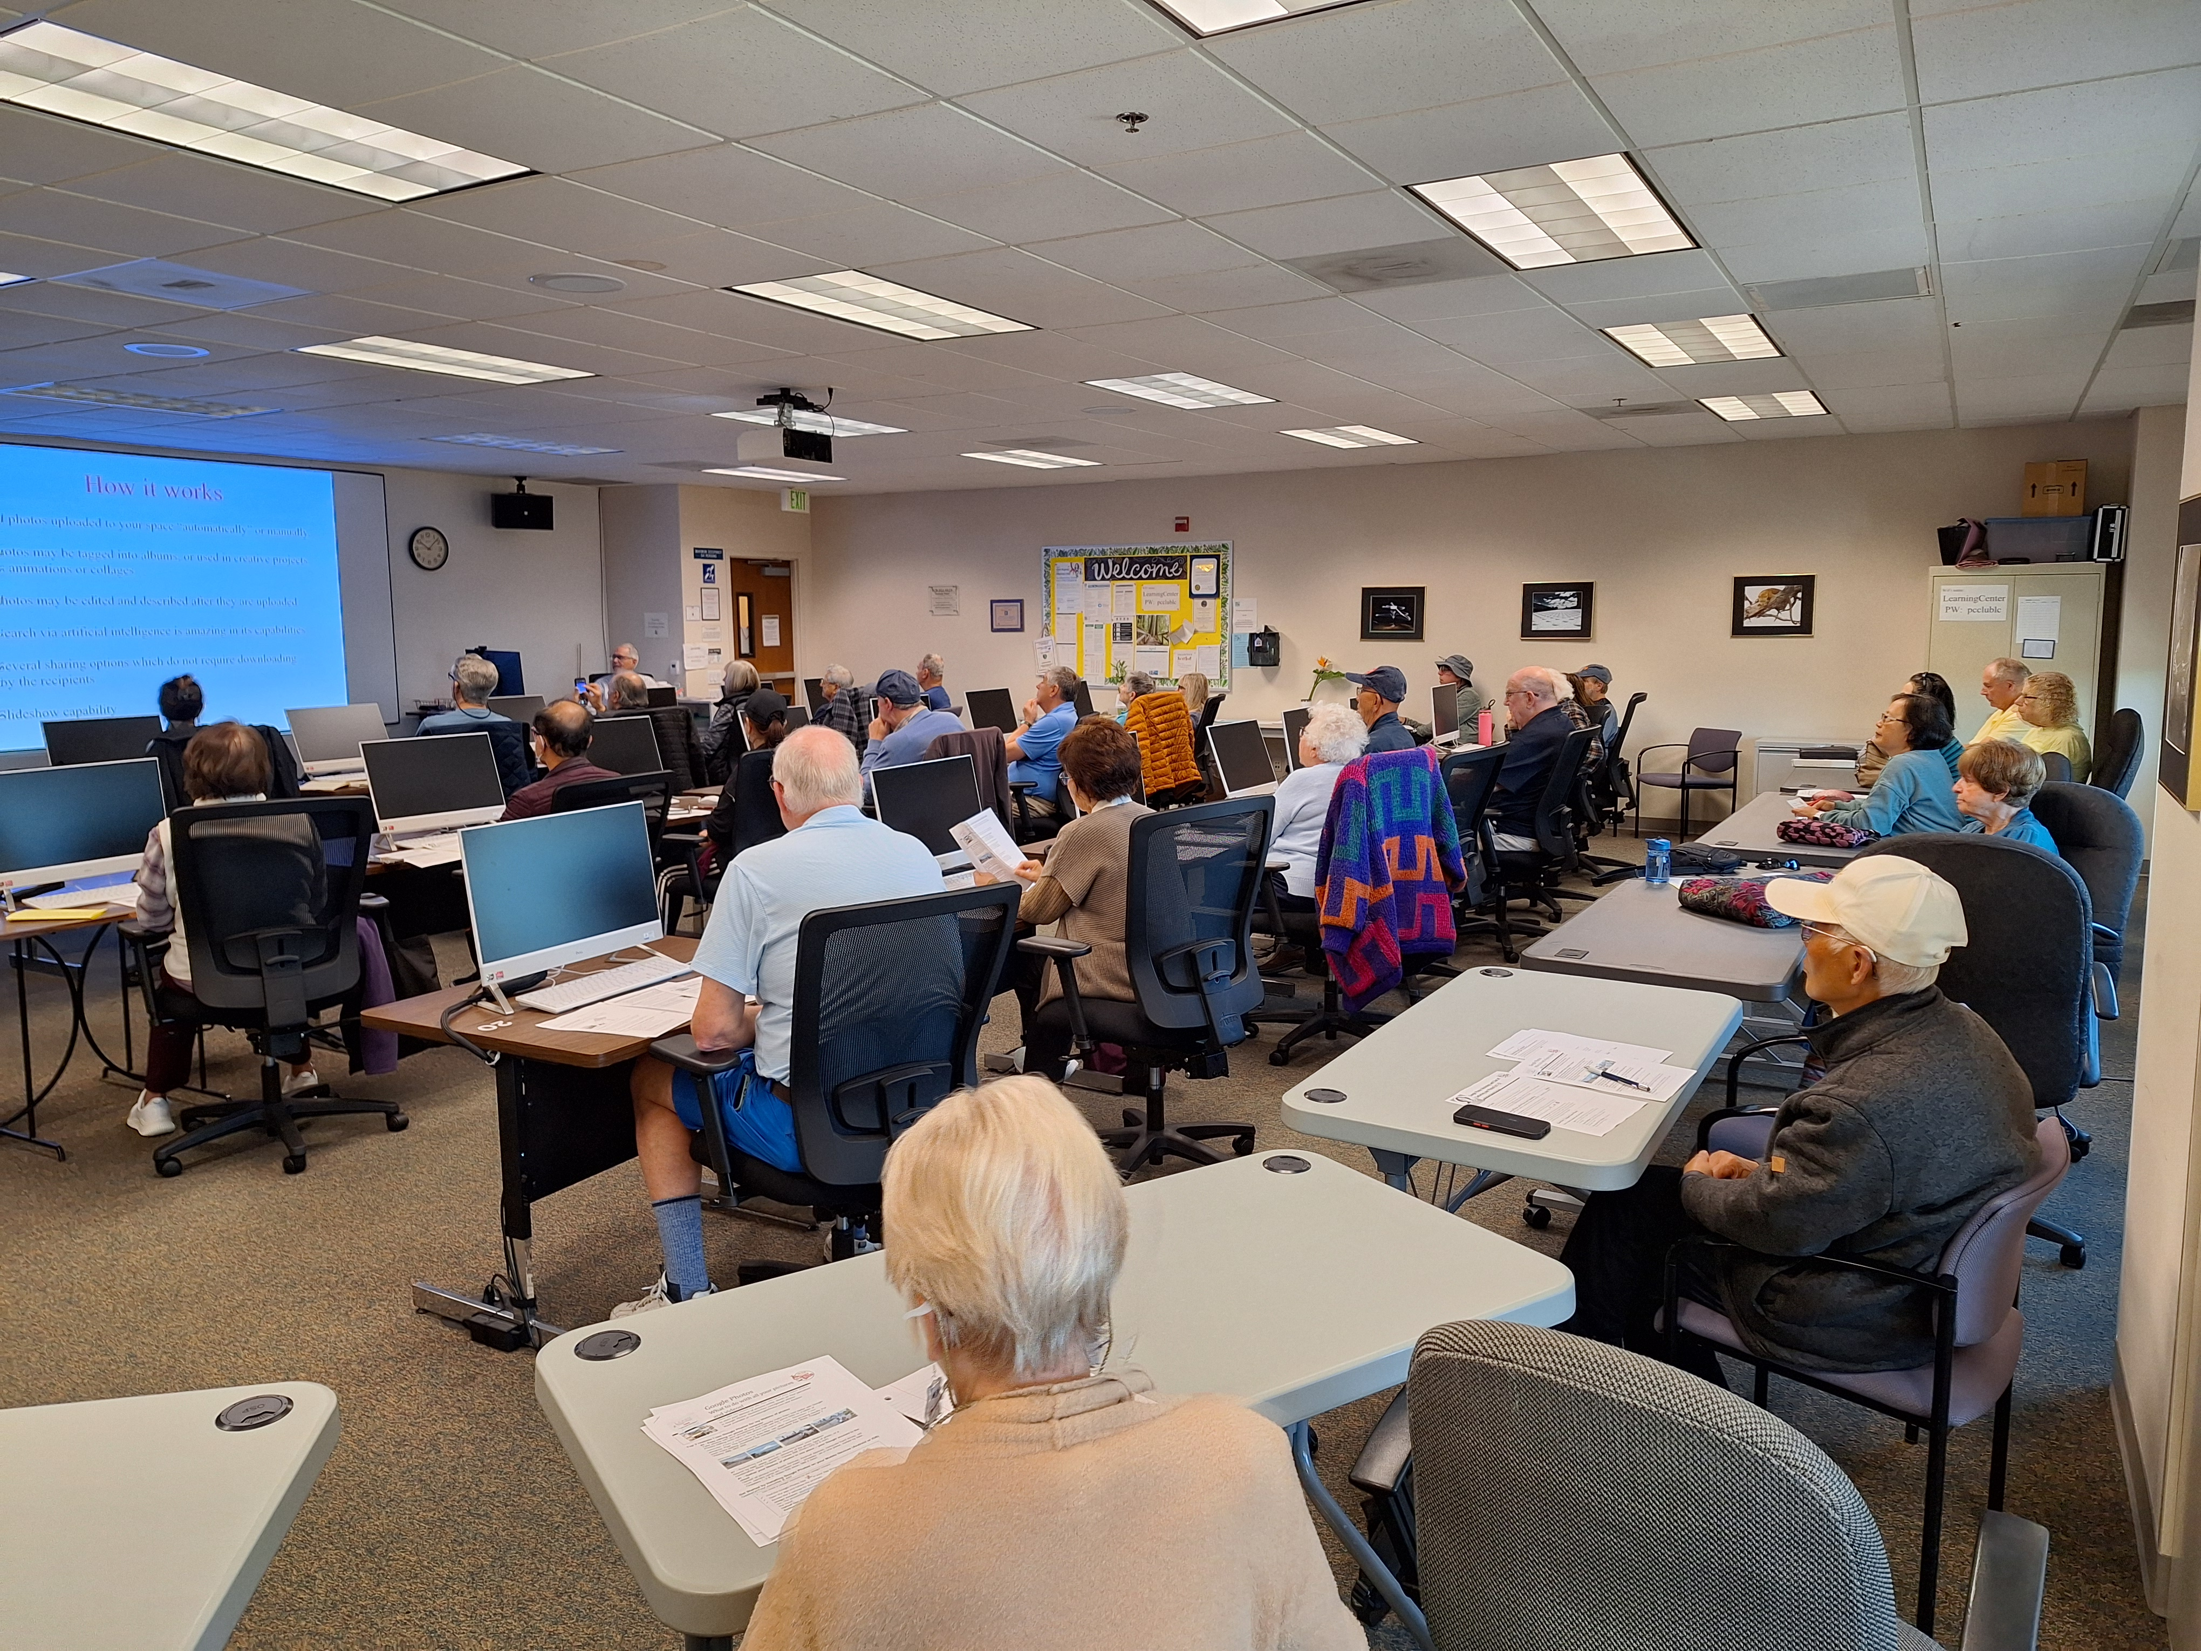
PC Club FREE CLASSES
Classes open to LWV residents & their guests
12 Volunteer Instructors conducted:
– 2023: 114 classes 2,400 students
– 2024: 59 classes 925 students
Google Photos Class →

Slide 6
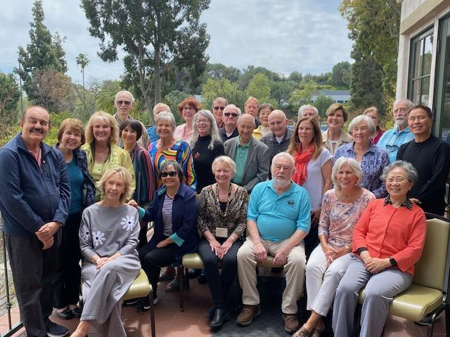
PC Club FREE TAX PROGRAM
Program offered 25+ years
Barbara Harris, Site Coordinator since 2009
All Volunteer Program
January-November 2023:
35 Counselors & Facilitators:
1,154 returns prepared & filed for 2022
January-April 2024:
46 Counselors & Facilitators:
1,220 returns prepared & filed for 2023

Slide 7
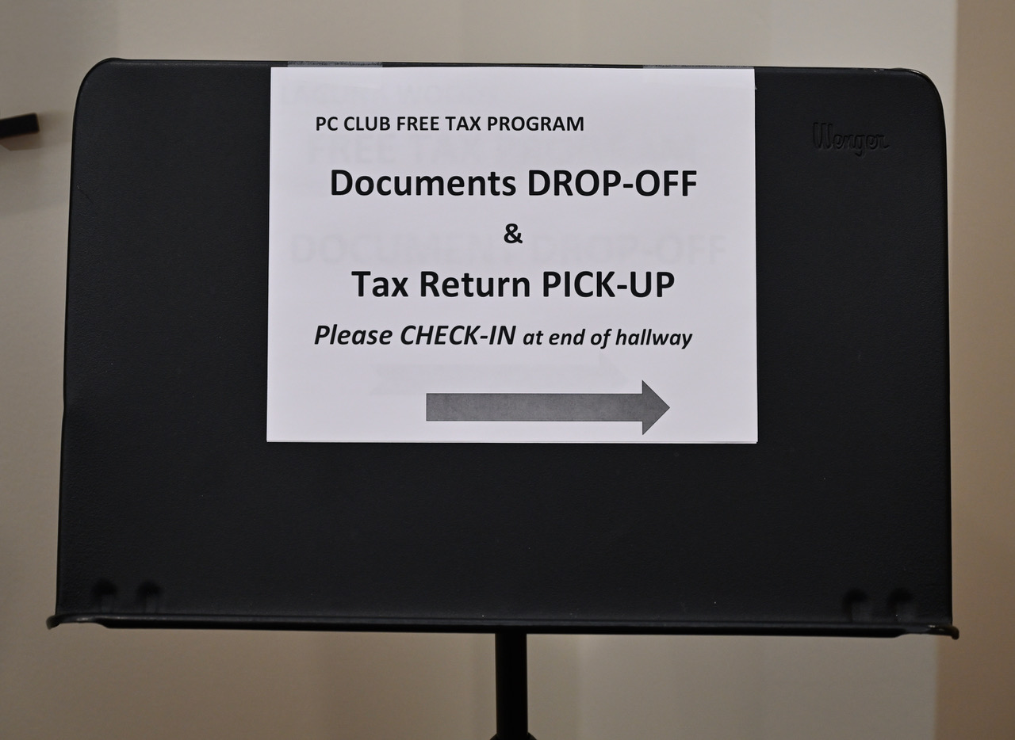
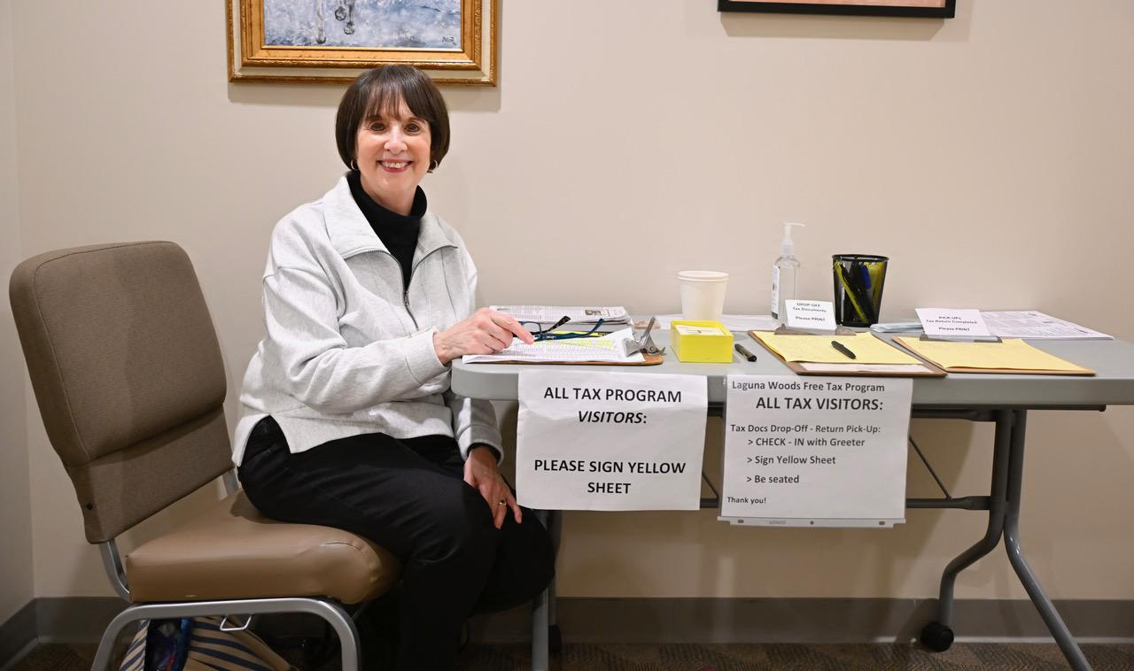
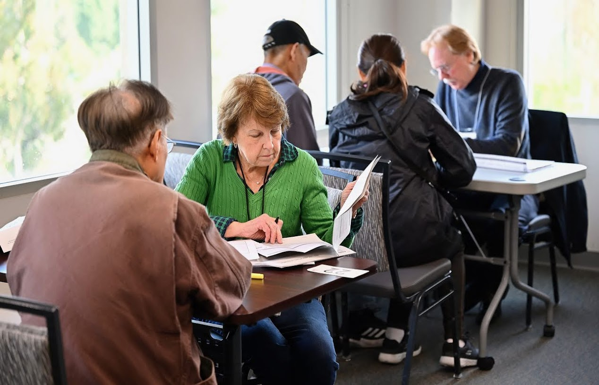
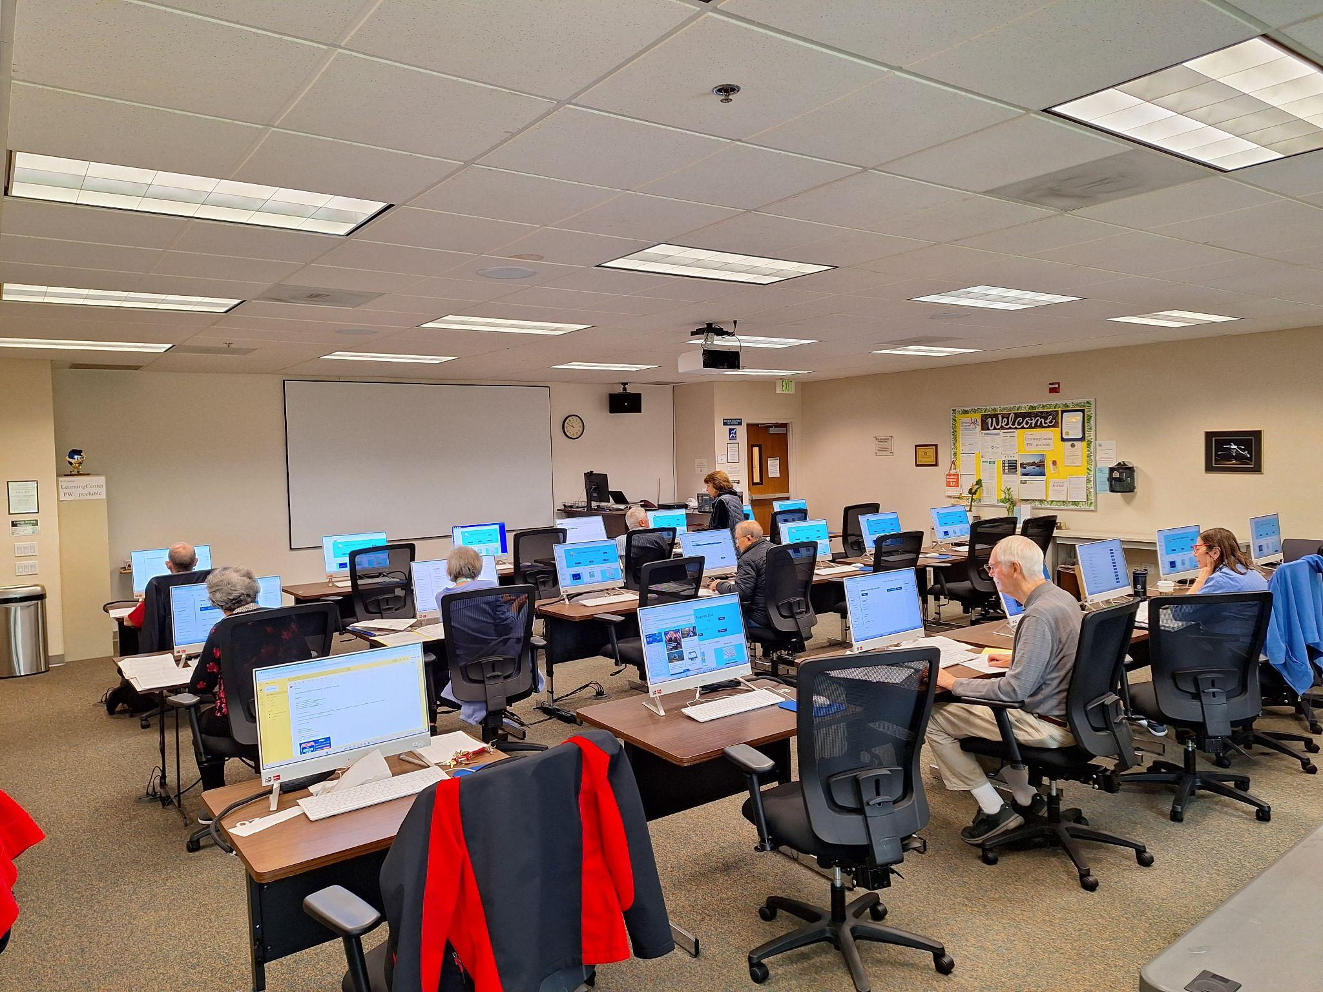
Free Tax Program Volunteers In Action

Slide 8
PC Club MEMBERSHIP
Only $10 for 12 months
Benefits of Membership:
- Discounted tickets for Annual Events
- Discounted USB flash drives, photo paper (sold in Workshop)
- Participation in Monthly Meeting Drawings
- Affiliation/benefits of the National Seniors Computers User Group

Slide 9
PC Club WANTS YOU
Please share just 3 hours/week (or occasionally substitute) as a:
Greeter: welcome & assist visitors
Supervisor: assist with computer requests
Class Instructor: share your computer knowledge/skills

